Slide 1
Data Analytics
Monica Goud

Slide 2
Data analysis is defined as a process of cleaning, transforming, and modeling data to discover useful information for business decision making.
The purpose of Data Analysis is to extract useful information from data and take the decision based upon the data analysis.
There are several types of Data Analysis techniques that exist based on business and technology.
However, the major Data Analysis methods are: – Text Analysis
– Descriptive Analysis
– Diagnostic Analysis
– Predictive Analysis
– Prescriptive Analysis

Slide 3
Descriptive Analysis
Descriptive analytics helps answer questions about what happened. These techniques summarize large datasets to describe outcomes to stakeholders.
By developing key performance indicators (KPIs,) these strategies can help track successes or failures. Metrics such as return on investment (ROI) are used in many industries.
Specialized metrics are developed to track performance in specific industries. This process requires the collection of relevant data, processing of the data, data analysis and data visualization. This process provides essential insight into past performance.

Slide 4
Diagnostic analytics
Diagnostic analytics helps answer questions about why things happened. These techniques supplement more basic descriptive analytics.
They take the findings from descriptive analytics and dig deeper to find the cause. The performance indicators are further investigated to discover why they got better or worse. This generally occurs in three steps:
– Identify anomalies in the data. These may be unexpected changes in a metric or a particular market.
– Data that is related to these anomalies is collected. – Statistical techniques are used to find relationships and trends that explain these anomalies.

Slide 5
Predictive analytics
Predictive analytics helps answer questions about what will happen in the future. These techniques use historical data to identify trends and determine if they are likely to recur.
Predictive analytical tools provide valuable insight into what may happen in the future and its
techniques include a variety of statistical and machine learning techniques, such as: neural networks, decision trees, and regression.

Slide 6
Prescriptive analytics
Prescriptive analytics helps answer questions about what should be done. By using insights from predictive analytics, data-driven decisions can be made.
This allows businesses to make informed decisions in the face of uncertainty. Prescriptive analytics techniques rely on machine learning strategies that can find patterns in large datasets.
By analyzing past decisions and events, the likelihood of different outcomes can be estimated.

Slide 7
Cluster analysis
The action of grouping a set of data elements in a way that said elements are more similar (in a particular sense) to each other than to those in other groups – hence the term ‘cluster.’
• Since there is no target variable when clustering, the method is often used to find hidden patterns in the data. The approach is also used to provide additional context to a trend or dataset.

Slide 8
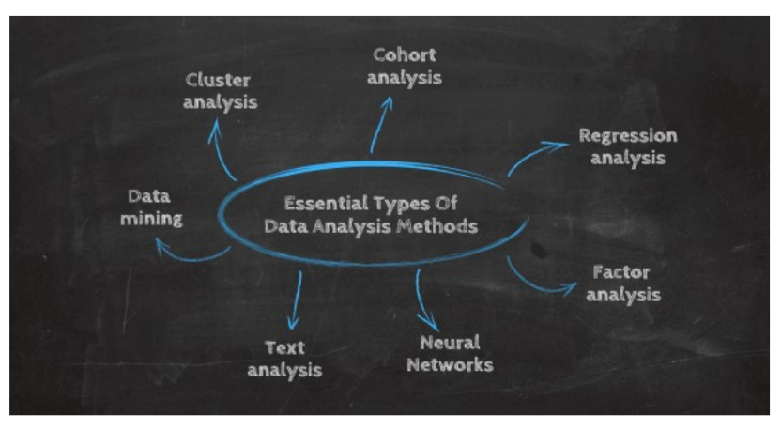

Slide 9
Cohort analysis
This type of data analysis method uses historical data to examine and compare a determined segment of users' behavior, which can then be grouped with others with similar characteristics.
• By using this data analysis methodology, it's possible to gain a wealth of insight into consumer needs or a firm understanding of a broader target group.
• Cohort analysis can be really useful to perform analysis in marketing as it will allow you to understand the impact of your campaigns on specific groups of customers.

Slide 10
Regression analysis
The regression analysis uses historical data to understand how a dependent variable's value is affected when one (linear regression) or more independent variables (multiple regression) change or stay the same.
• By understanding each variable's relationship and how they developed in the past, you can anticipate possible outcomes and make better business decisions in the future.

Slide 11
Neural networks
The neural network forms the basis for the It is intelligent algorithms of machine learning.
It is a form of data-driven analytics that attempts, with minimal intervention, to understand how the human brain would process insights and predict values.
• Neural networks learn from each and every data transaction, meaning that they evolve and advance over time.

Slide 12
Factor analysis
• The factor analysis, also called “dimension reduction,” is a type of data analysis used to describe variability among observed, correlated
variables in terms of a potentially lower number of unobserved variables called factors.
• The aim here is to uncover independent latent variables, an ideal analysis method for streamlining specific data segments.

Slide 13
Data Mining
• A method of analysis that is the umbrella term for engineering metrics and insights for additional value, direction, and context.
• By using exploratory statistical evaluation, data mining aims to identify dependencies, relations, data patterns, and trends to generate and advanced knowledge.
• When considering how to analyze data, adopting a data mining mindset is essential to success - as such, it’s an area that is worth exploring in greater detail.

Slide 14
Text analysis
• Text analysis, also known in the industry as text mining, is the process of taking large sets of textual data and arranging it in a way that
makes it easier to manage.
• By working through this cleansing process in stringent detail, you will be able to extract the data that is truly relevant to your business and
use it to develop actionable insights that will propel you forward.

Slide 15
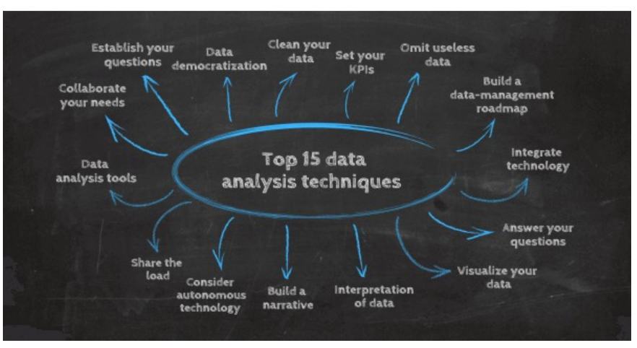
Data Analysis Techniques

